Slide 1


PITCH BOOK
ACQUIRER
TARGET
GROUP 1
NAMES:
SINKU KUMAR
PRANAV PANDEY
ATHUL PRATHAP
NISHA SINGH
SOURAV AGARWAL
MEGHA SRIVASTAVA
JATIN BUDHANI
STUDENT ID:
23A2HP406
23A2HP414
23A2HP432
23A2HP435
23A2HP438
23A2HP460
23A2HP465

Slide 2
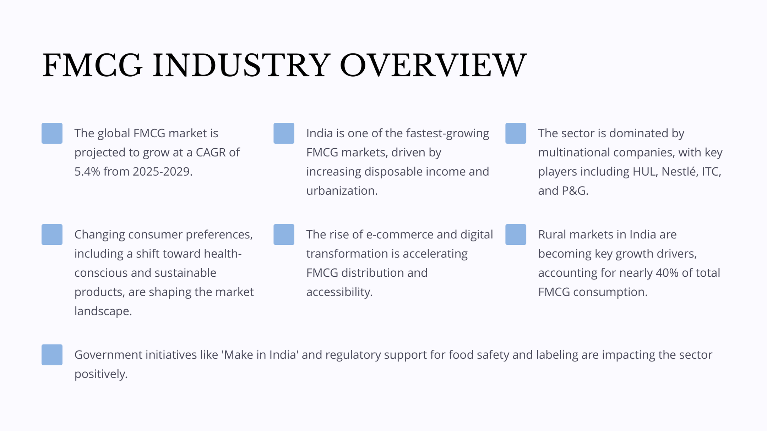

Slide 3
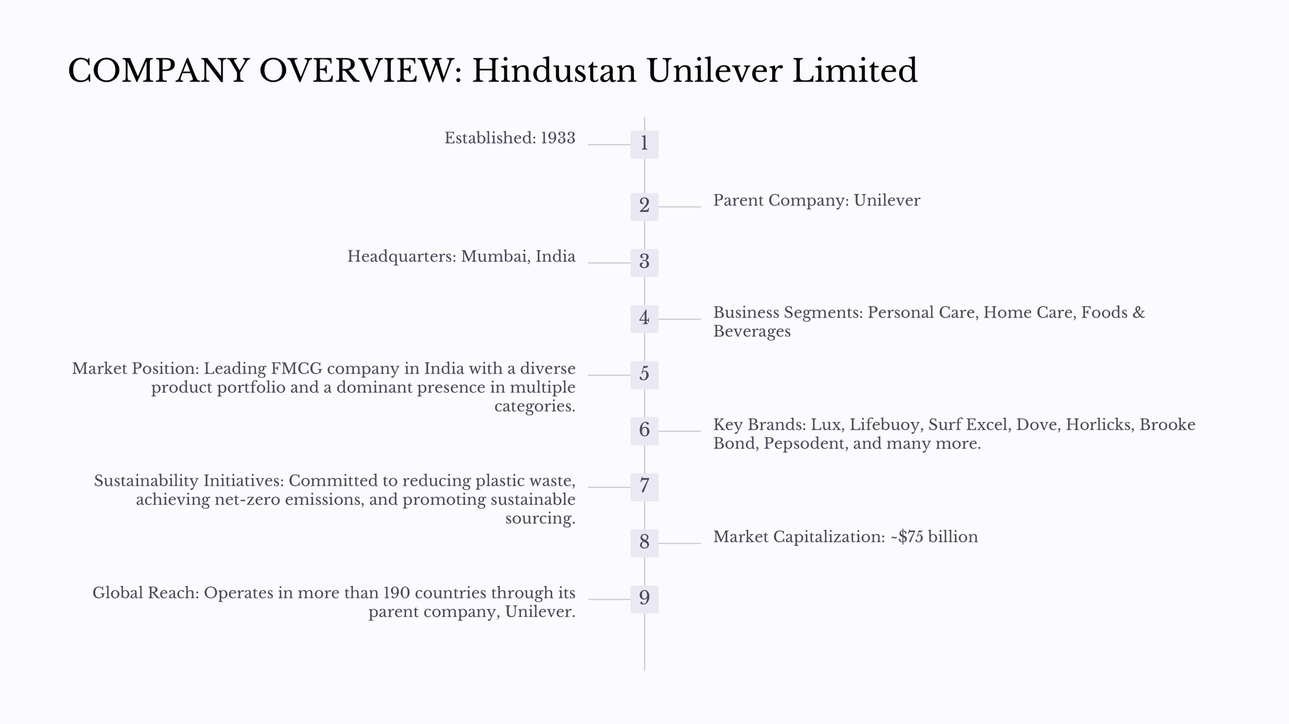

Slide 4
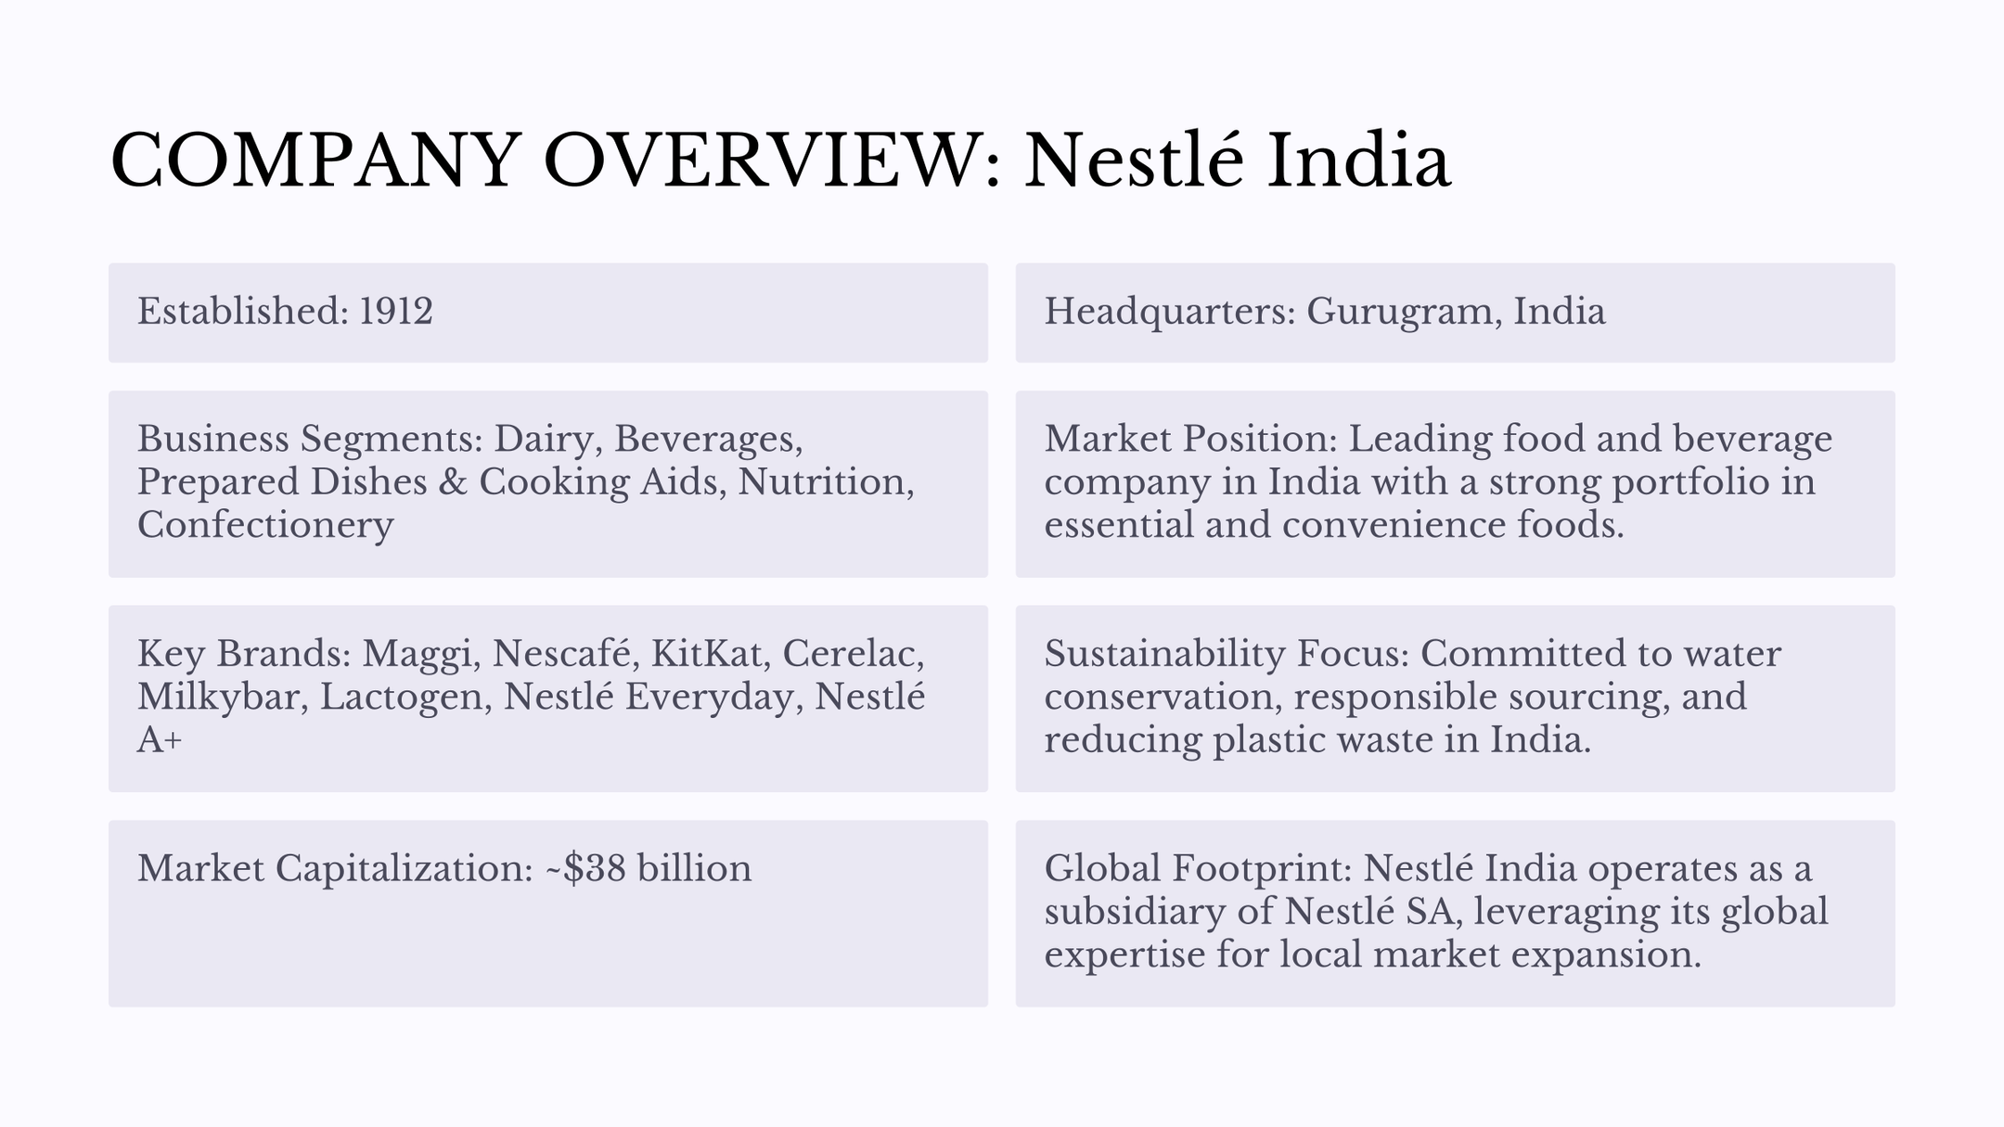

Slide 5
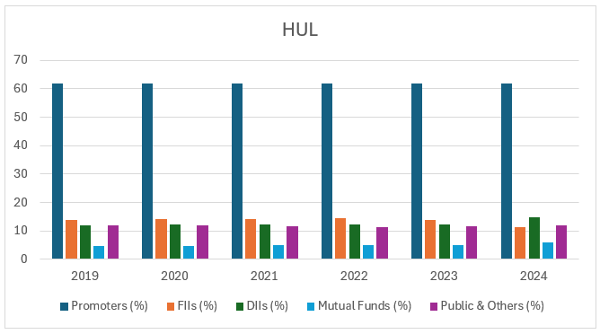
Shareholding Pattern: Hindustan Unilever Ltd

Slide 6
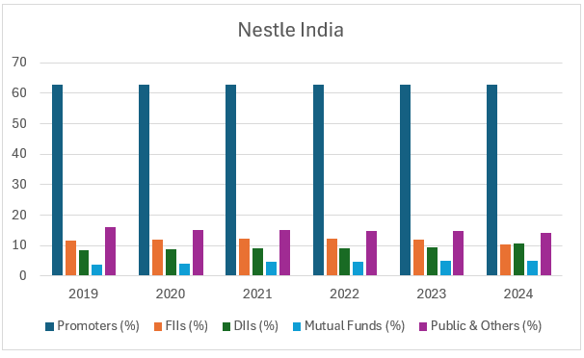
Shareholding Pattern: Nestle India

Slide 7
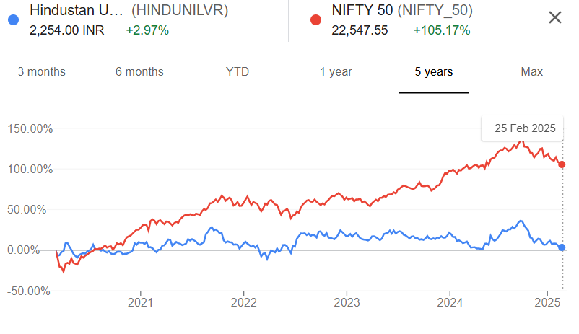
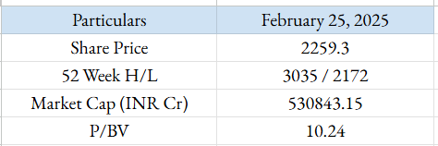
Stock Perfomance: Hindustan Unilever Ltd

Slide 8
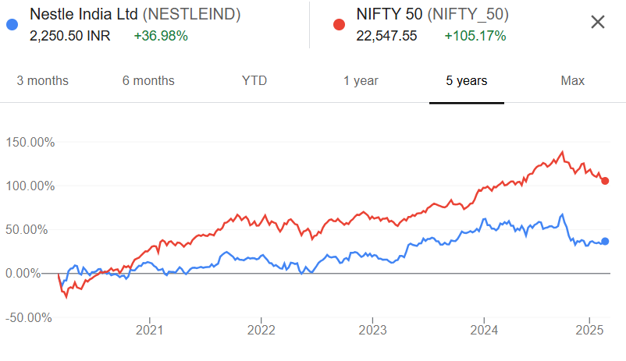
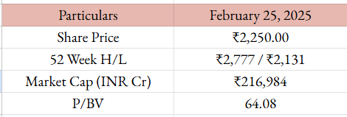
Stock Perfomance: Nestle India

Slide 9
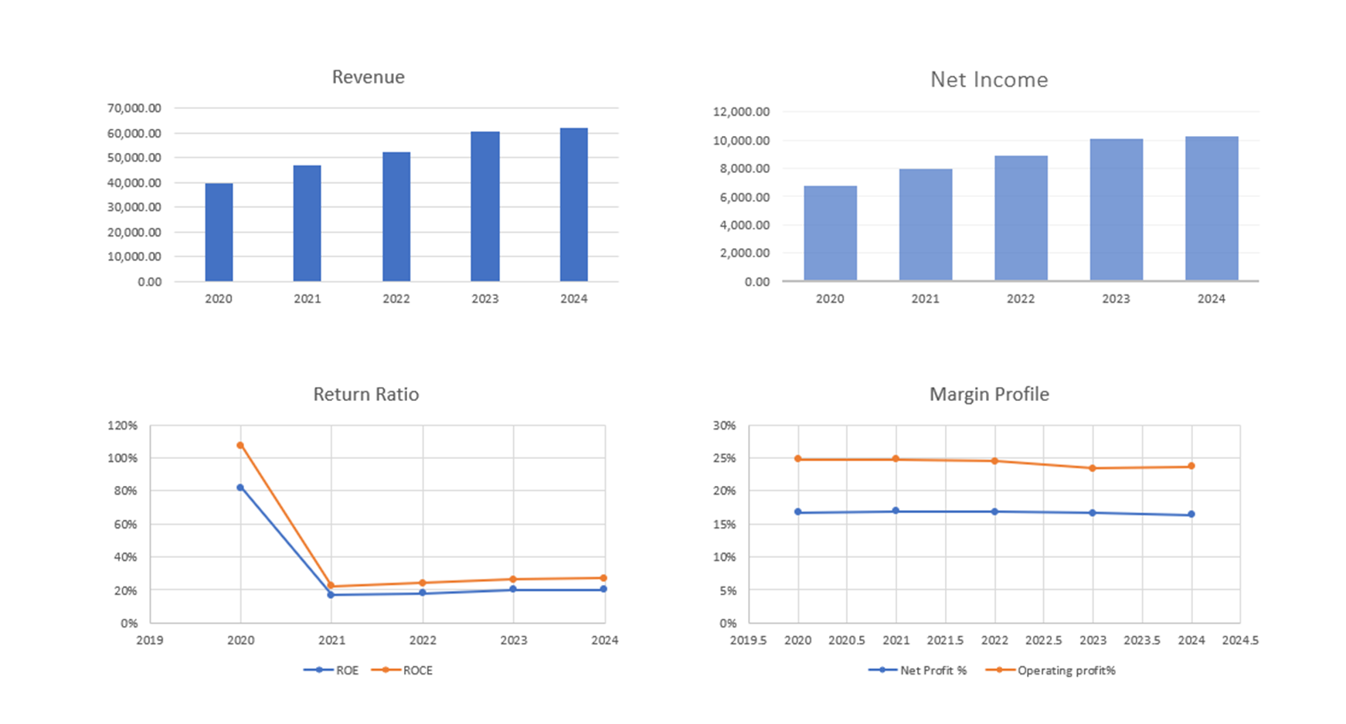
Financial Analysis : HUL

Slide 10
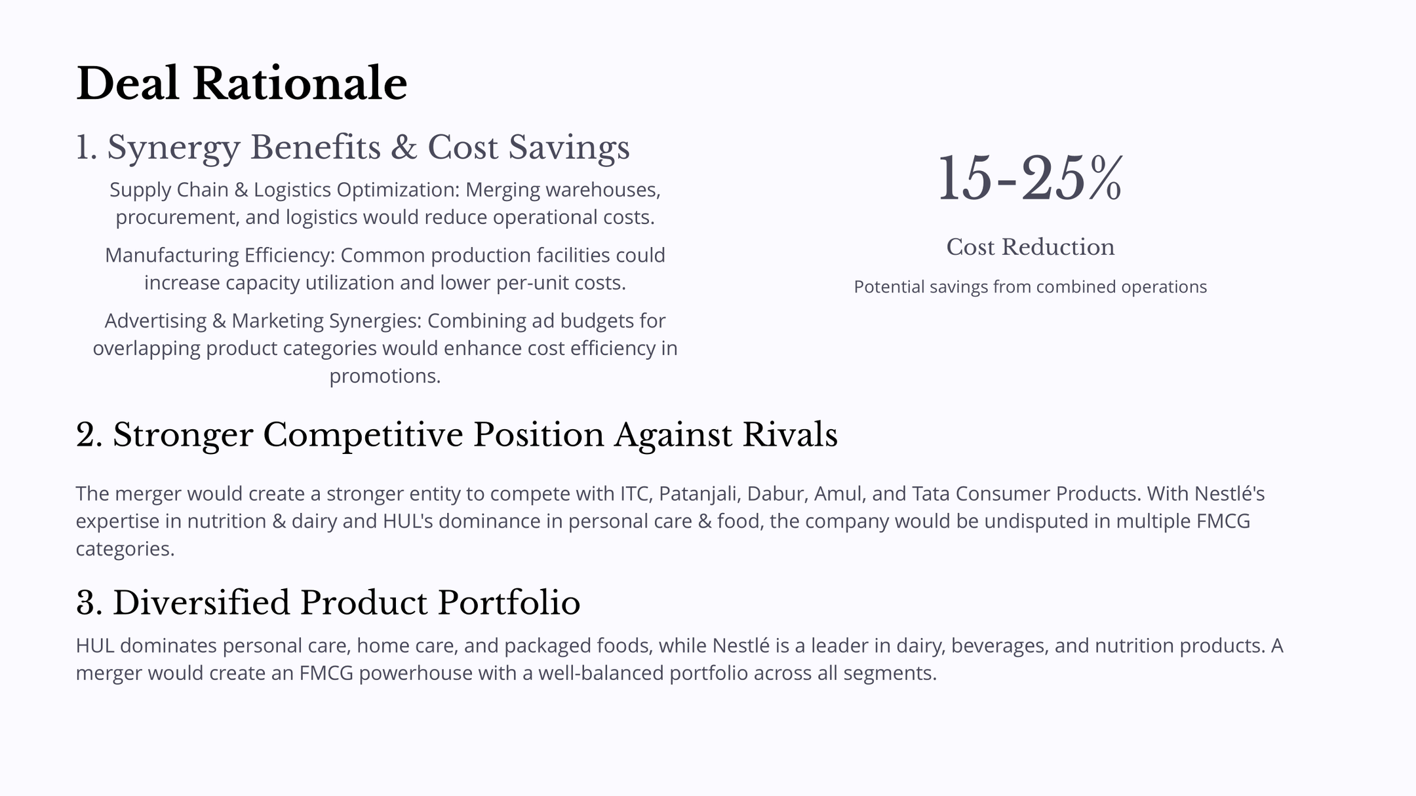

Slide 11
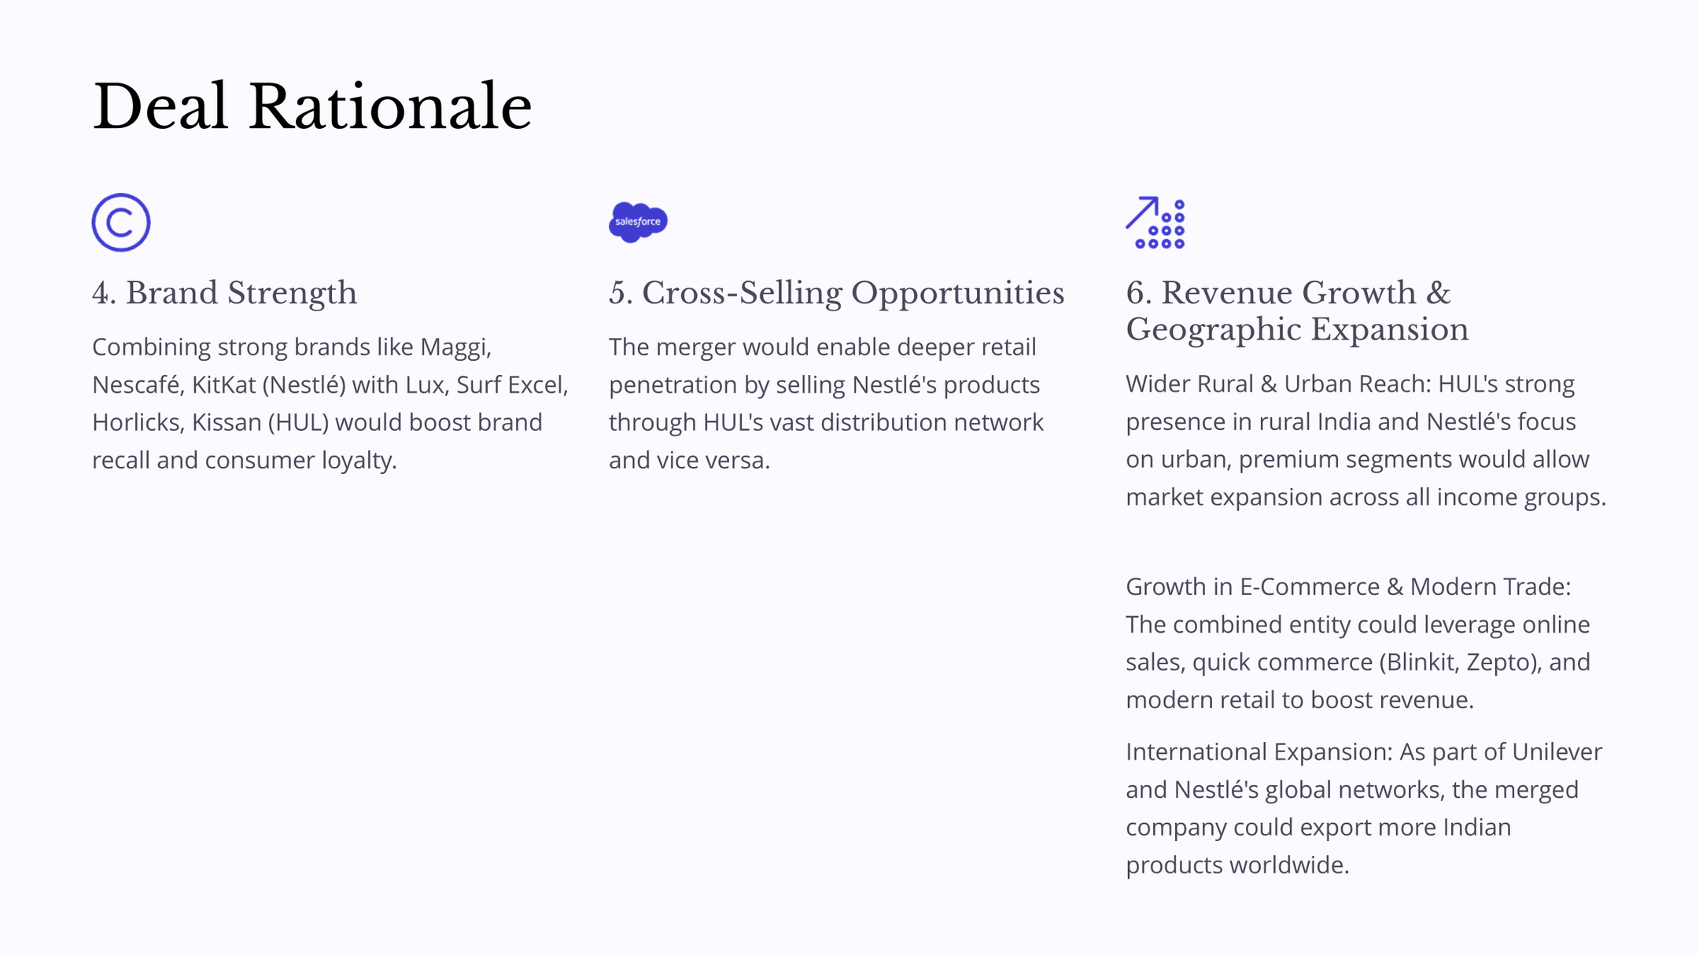

Slide 12
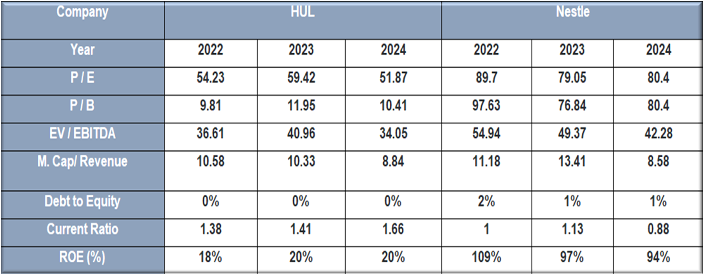
Market Multiples

Slide 13
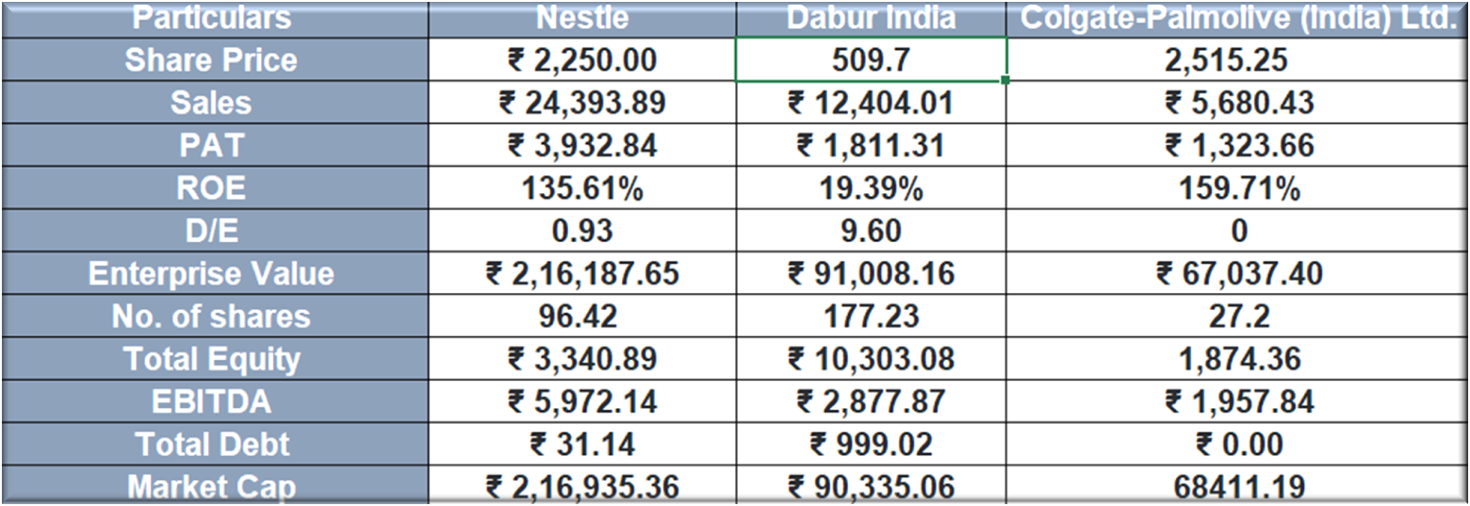
Peer Comparison

Slide 14
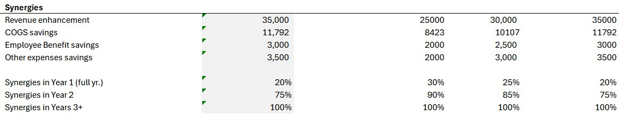
Synergy
Total Synergy value for the combined entity for
Optimistic - ₹11,227 crores
Normal - ₹11,402 crores
Pessimistic - ₹10,685 crores
which is distributed over 3 years (as given photo).

Slide 15
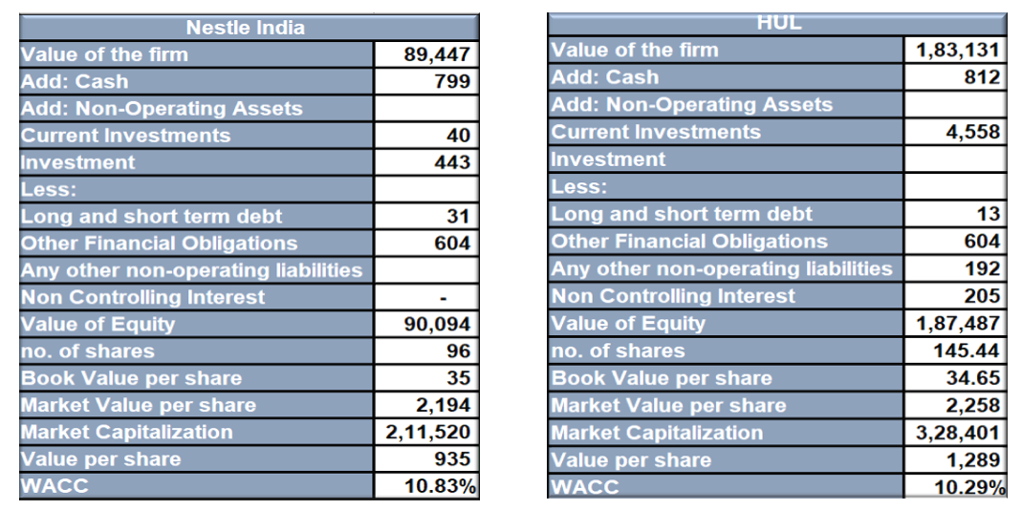
DCF Valuation

Slide 16
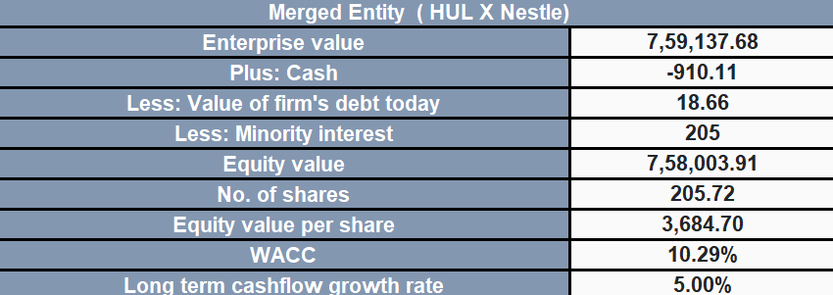
DCF Valuation

Slide 17
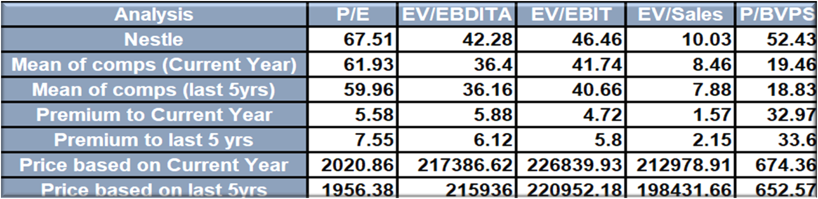
Valuation Summary
(Nestle India)

Slide 18
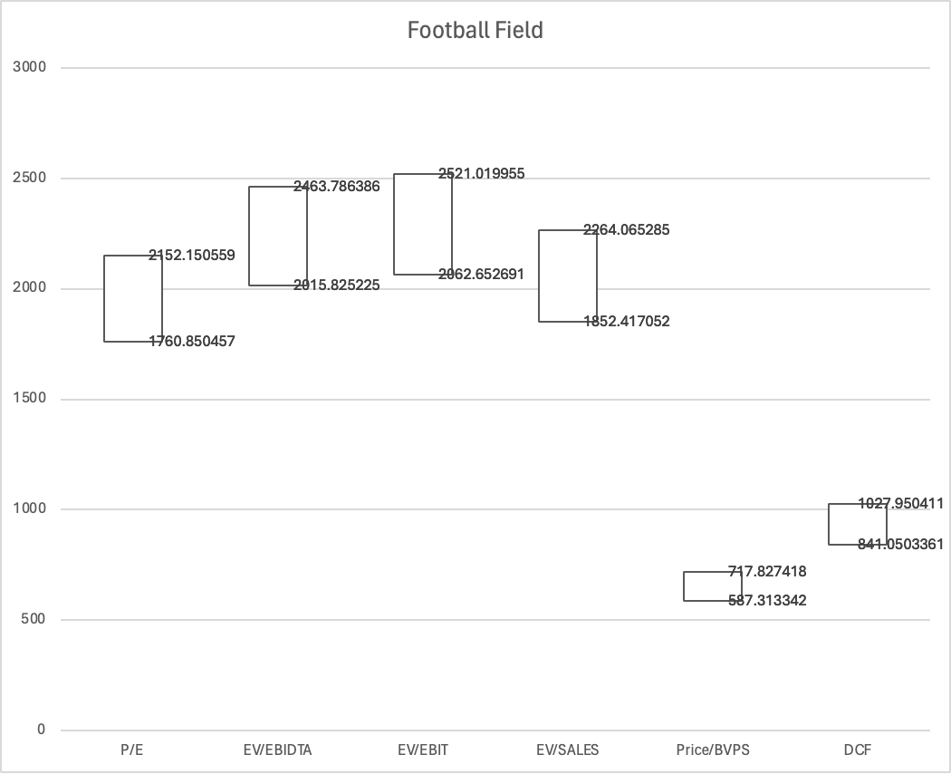

Slide 19
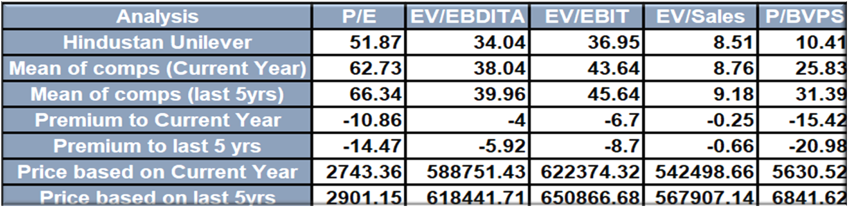
Valuation Summary
(Hindustan Unilever Limited)

Slide 20
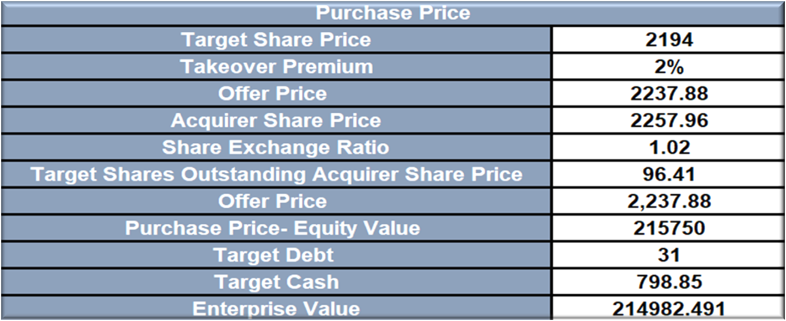
Price to be paid
Nestle India is valued at 2,14,982.5 crores for acquisition with a share price of 2,237.88 at 2% premium than the market price of 2,194.

Slide 21
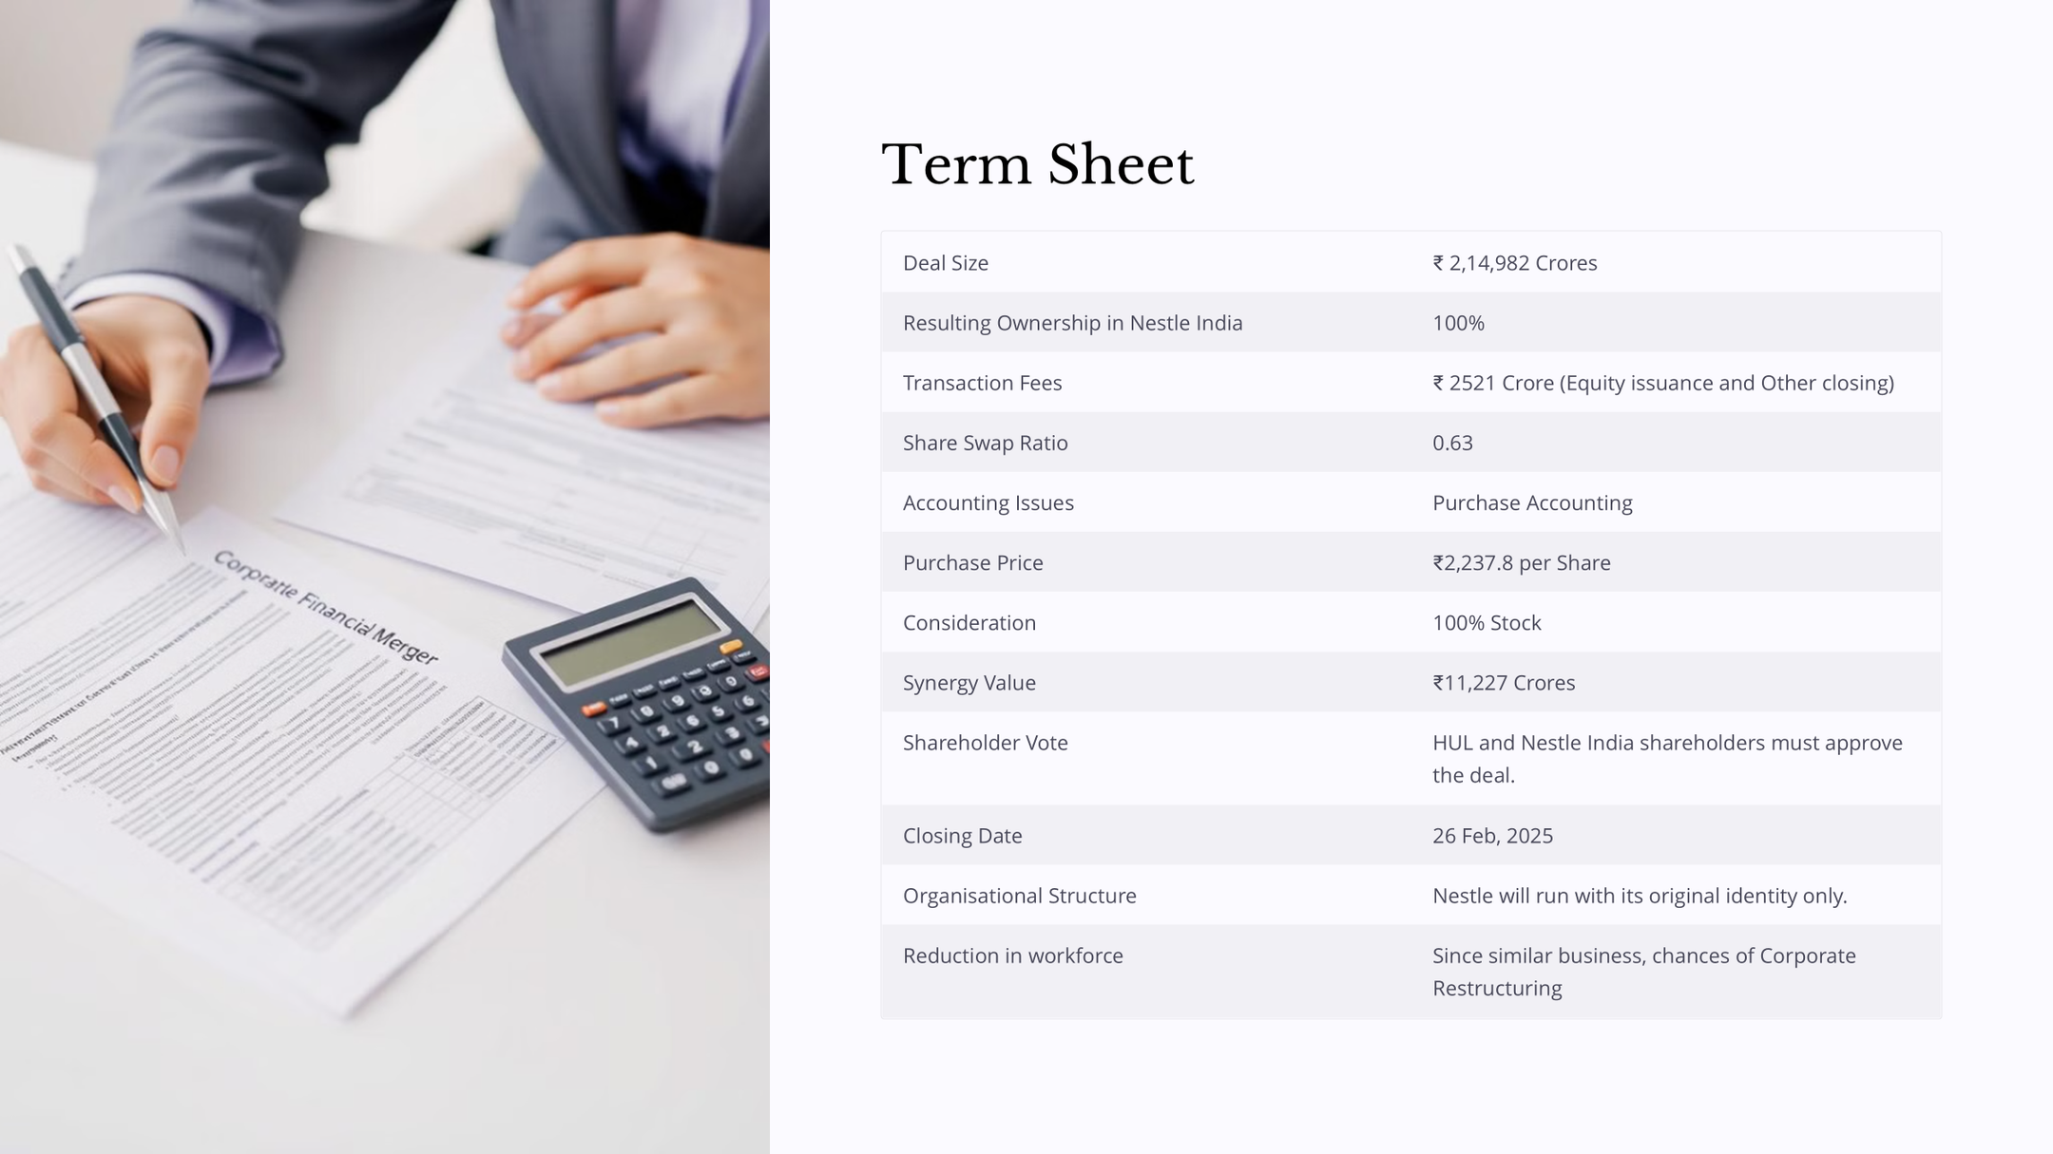

Slide 22
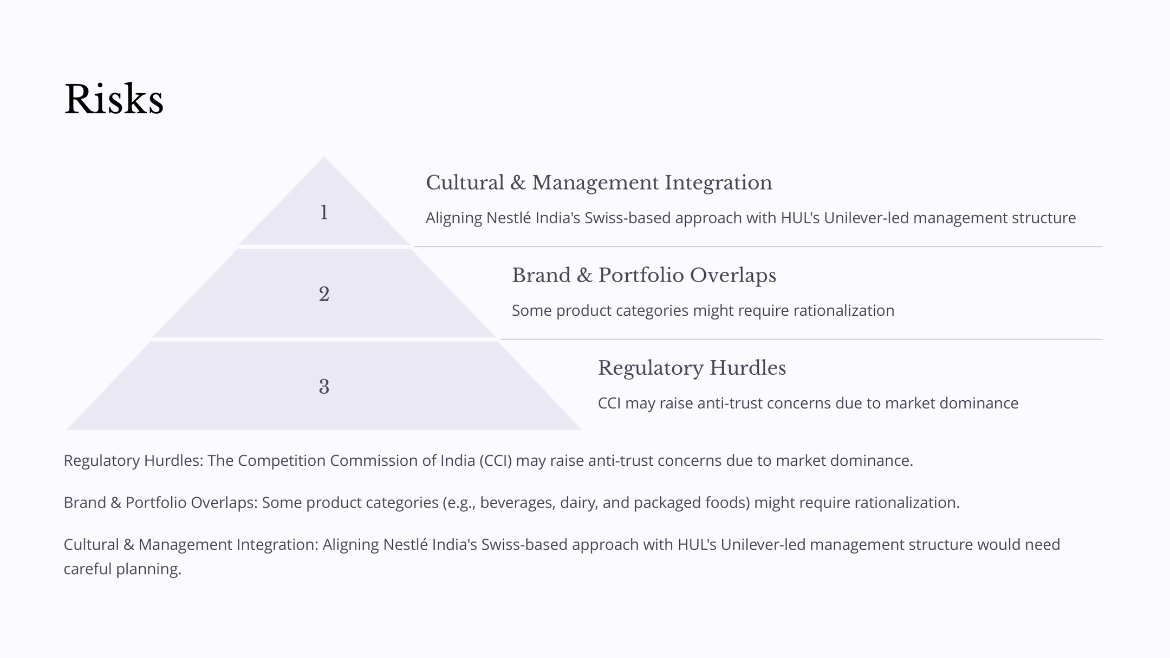

Slide 23
Thank You!

